Slide 1

Salary Prediction Using Linear Regression
Koushik Kundu
Machine Learning Project • Computer Science Department

Slide 2

Introduction to Salary Prediction
Salary prediction is a machine learning application that estimates compensation based on employee attributes and market factors. This predictive approach helps organizations make data-driven decisions about compensation strategies.
Understanding salary trends is crucial for both employers seeking competitive hiring practices and employees negotiating fair compensation in today's dynamic job market.

Slide 3







Project Objective
Primary Goal
Key Features
Develop a predictive model that accurately estimates salary based on employee characteristics
Age, Gender, Education Level, Job Title, Years of Experience and Salary
Expected Outcome
Create a reliable linear regression model with strong predictive performance

Slide 4
Dataset Description
6500+
8
3
Data Records
Key Features
Data Sources
Comprehensive dataset with employee information
Including experience, education, and role
Industry surveys and HR databases
Primary Features
Years of Experience: Continuous variable (0-40 years)
Age: Continuous variable (e.g., 18–65 years)
Education Level: Categorical variable (High School, Bachelor’s, Master’s, PhD, etc.)
Gender: Categorical variable (Male, Female, Other)
Salary: Annual salary (in Rupees)
Job Role: Engineer, Manager, Analyst, etc.

Slide 5
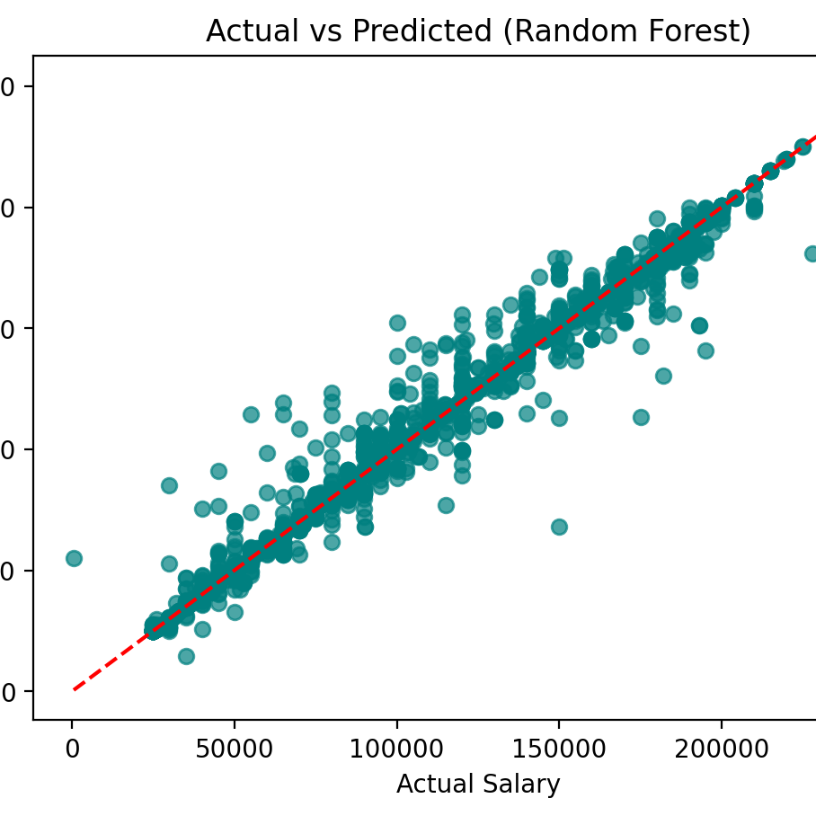
Why Linear Regression?
Model Characteristics
The scatter plot shows actual vs predicted salaries using Random Forest. Points closely follow the diagonal line, indicating strong prediction accuracy and the model’s ability to capture salary patterns effectively.
Key Advantages
High Accuracy: Predictions closely follow the ideal line, showing strong model performance.
Captures Non-Linear Patterns: Handles complex salary relationships better than linear models.
Robust to Outliers: Random Forest reduces the impact of noisy or extreme salary values.
Generalizes Well: Consistent predictions across diverse data points indicate good real-world reliability.

Slide 6




Implementation Workflow
Data Loading
Preprocessing
Import dataset using Pandas and perform initial exploration
Clean, encode, and scale features for model readiness
Model Training
Evaluation
Fit LinearRegression from Scikit-learn on training data
Test predictions and calculate performance metrics
Core Technologies
Python Libraries: Pandas for data manipulation, NumPy for numerical operations, Matplotlib/Seaborn for visualization
Scikit-learn: LinearRegression model, train_test_split, StandardScaler, and evaluation metrics

Slide 7
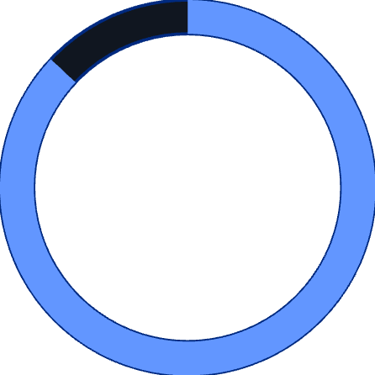


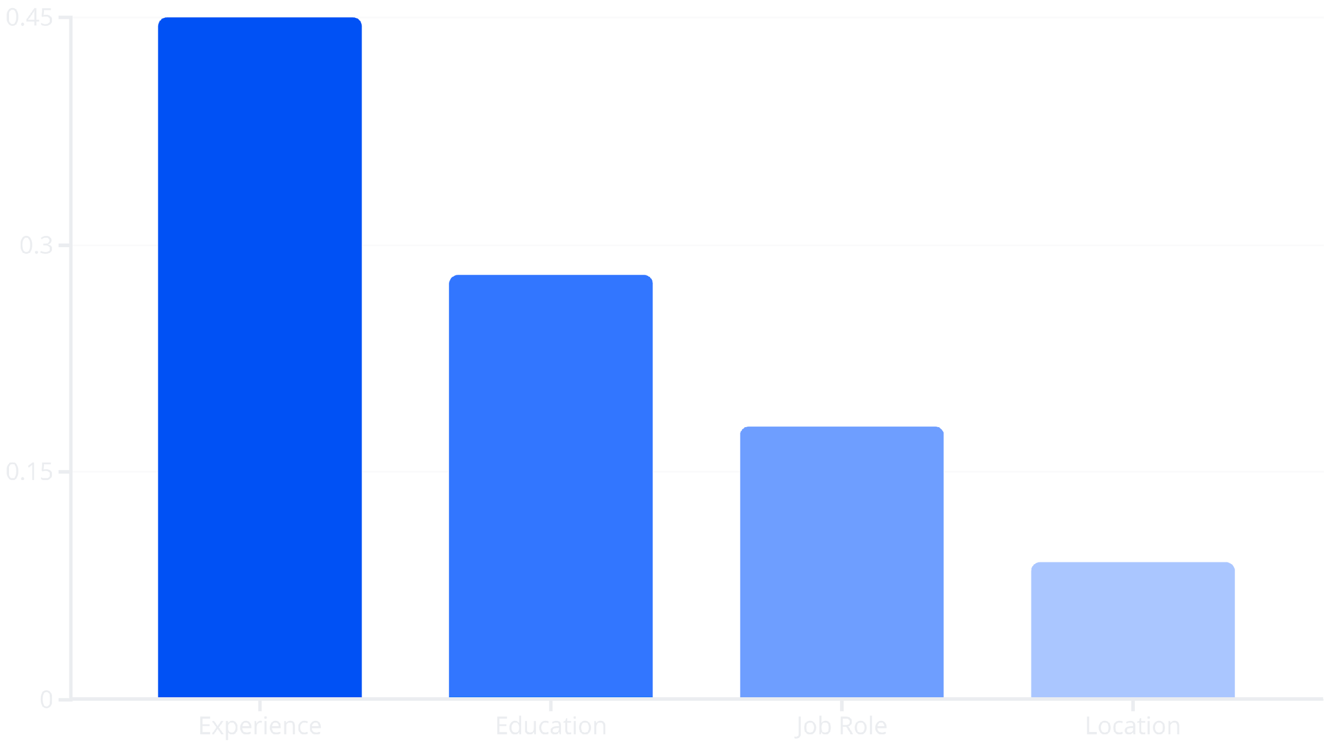
Results & Model Performance
87%
12%
15%
R² Score
Mean Absolute Error
RMSE Percentage
Strong correlation between predicted and actual salaries
Average prediction error of $7,200 on $60K average salary
Root mean squared error indicating good model fit
The model demonstrates strong predictive capability with R² of 0.87, indicating that 87% of salary variance is explained by our features. Experience emerged as the most influential predictor.

Slide 8
Challenges & Solutions
Outlier Detection
Feature Multicollinearity
Imbalanced Categories
Challenge: Extreme salary values skewed the model predictions and affected overall performance.
Challenge: High correlation between education and experience created redundancy in the model.
Challenge: Some job roles had very few samples, leading to poor predictions for rare categories.
Solution: Applied IQR method to identify and remove outliers beyond 1.5 times the interquartile range.
Solution: Grouped similar roles together and ensured minimum sample size per category.
Solution: Calculated VIF scores and removed highly correlated features to improve model stability.

Slide 9

Conclusion & Future Directions
Key Takeaways
Future Enhancements
Successfully developed a linear regression model achieving 87% accuracy in salary prediction. The project demonstrated that experience, education, and job role are primary factors influencing compensation.
Implement advanced models: Random Forest, XGBoost, Neural Networks
Include additional features: skills, certifications, company size
Develop interactive web application for real-time predictions
The model provides a solid foundation for data-driven salary estimation and can assist in compensation planning and career guidance.
Expand dataset with industry-specific salary data

